Slide 1
Machine Learning
Naïve Bayes & SVM

Slide 2


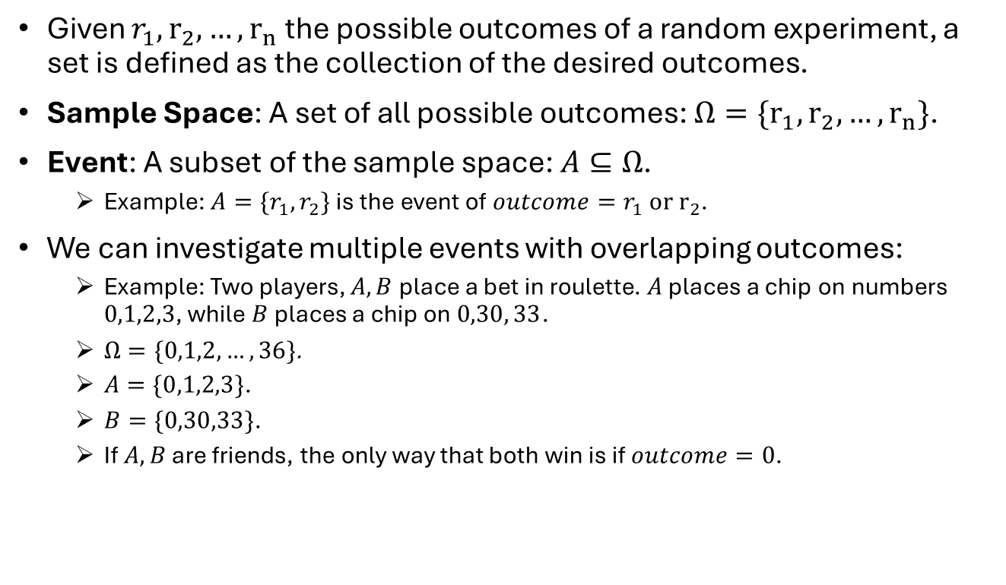



Sets
Given $r_{1},r_{2},…,r_{n}$ the possible outcomes of a random experiment, a set is defined as the collection of the desired outcomes.
Sample Space: A set of all possible outcomes: $Ω=\{r_{1},r_{2},…,r_{n}\}$.
Event: A subset of the sample space: $A⊆Ω$.
Example: $A=\{r_{1},r_{2}\}$ is the event of $outcome=r_{1} or r_{2}$.
We can investigate multiple events with overlapping outcomes:
Example: Two players, $A,B$ place a bet in roulette. $A$ places a chip on numbers $0,1,2,3$, while $B$ places a chip on $0,30, 33$.
$Ω=\{0,1,2,…,36\}$.
$A=\{0,1,2,3\}$.
$B=\{0,30,33\}$.
If $A,B$ are friends, the only way that both win is if $outcome=0$.
$$Ω=\{0,1,2,…,36\}$$
1 2 3
30
33
$$B$$
$$A$$
0

Slide 3
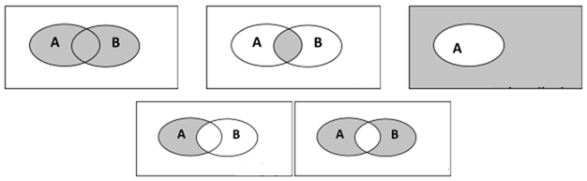
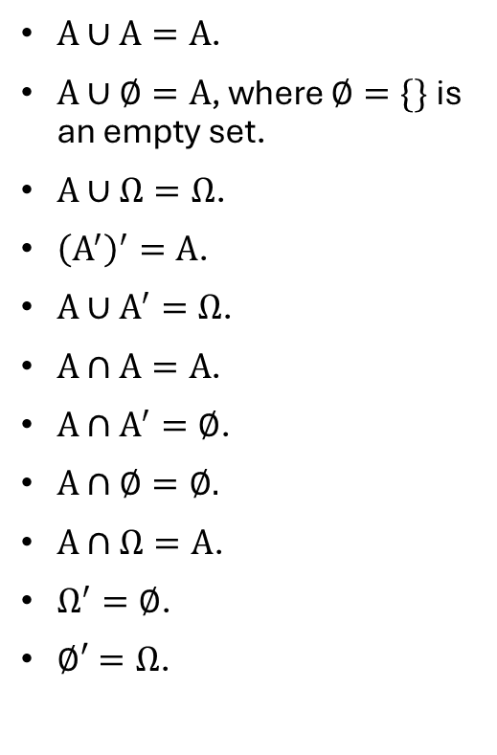

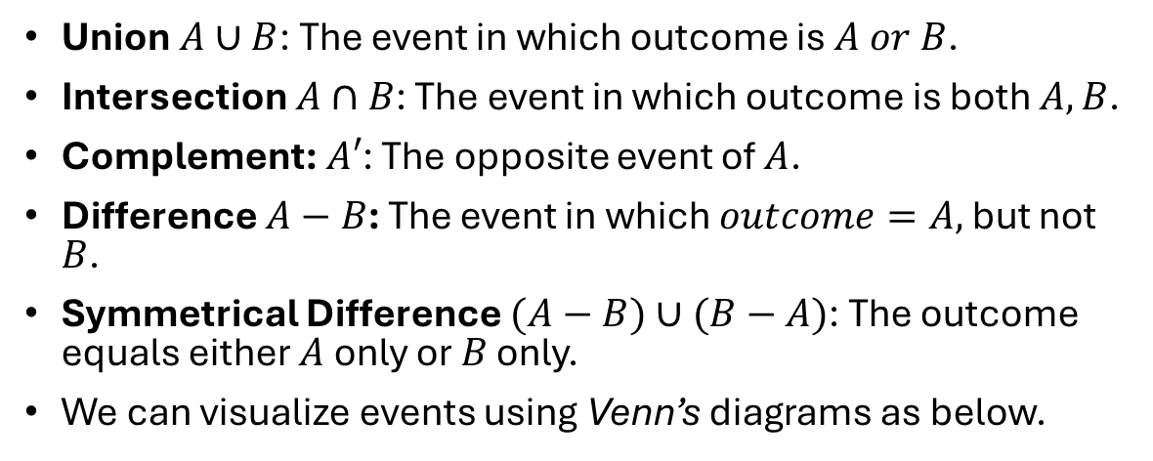



Set Operations
Union $A∪B$: The event in which outcome is $A or B$.
Intersection $A∩B$: The event in which outcome is both $A,B$.
Complement: $A′$: The opposite event of $A$.
Difference $A−B$: The event in which $outcome=A,$ but not $B$.
Symmetrical Difference $(A−B)∪(B−A)$: The outcome equals either $A$ only or $B$ only.
We can visualize events using Venn’s diagrams as below.
$Α∪Α=Α$.
$Α∪∅=Α$, where $∅=\{\}$ is an empty set.
$Α∪Ω=Ω$.
${\left(Α^{′}\right)}^{′}=Α$.
$Α∪Α^{′}=Ω$.
$Α∩Α=Α$.
$Α∩Α^{′}=∅$.
$Α∩∅=∅.$
$Α∩Ω=Α$.
$Ω^{′}=∅$.
$∅′=Ω$.
$$Ω$$
$$Ω$$
$$Ω$$
Union
Intersection
Complement
$$Ω$$
$$Ω$$
Difference
Symmetrical Difference

Slide 4
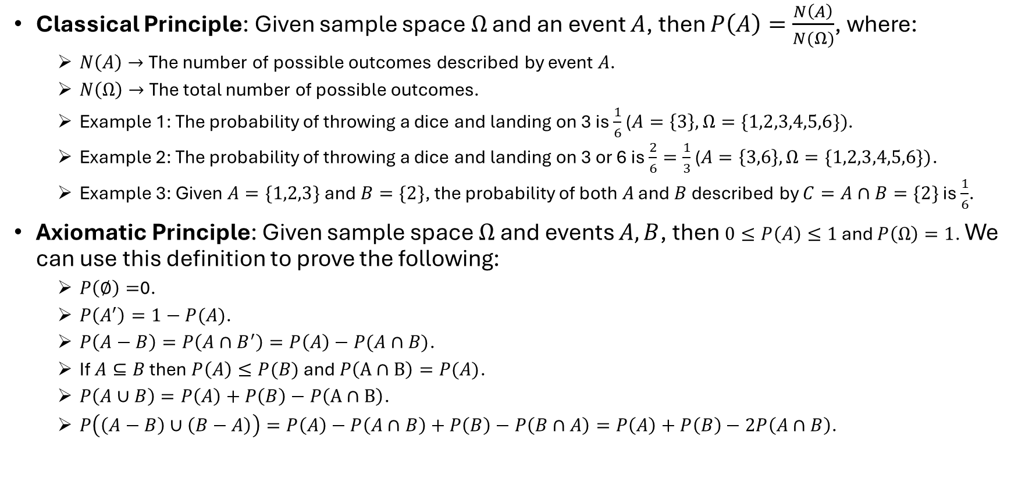
Probability Theory
Classical Principle: Given sample space $Ω$ and an event $A$, then $P\left(A\right)=\frac{N\left(A\right)}{N(Ω)}$, where:
$N\left(A\right)→$ The number of possible outcomes described by event $A$.
$N\left(Ω\right)→$ The total number of possible outcomes.
Example 1: The probability of throwing a dice and landing on 3 is $\frac{1}{6}$ ($A=\left\{3\right\}, Ω=\{1,2,3,4,5,6\})$.
Example 2: The probability of throwing a dice and landing on 3 or 6 is $\frac{2}{6}=\frac{1}{3}$ ($A=\left\{3,6\right\}, Ω=\{1,2,3,4,5,6\})$.
Example 3: Given $A=\{1,2,3\}$ and $B=\{2\}$, the probability of both $A$ and $B$ described by $C=A∩B=\{2\}$ is $\frac{1}{6}$.
Axiomatic Principle: Given sample space $Ω$ and events $A,B$, then $0≤P\left(A\right)≤1$ and $P\left(Ω\right)=1$. We can use this definition to prove the following:
$P\left(∅\right)=$0.
$P\left(A^{′}\right)=1−P(A)$.
$P\left(A−B\right)=P\left(A∩B^{′}\right)=P\left(A\right)−P(A∩B)$.
If $A⊆B$ then $P\left(A\right)≤P(B)$ and $P\left(Α∩Β\right)=P(A)$.
$P\left(A∪B\right)=P\left(A\right)+P\left(B\right)−P\left(Α∩Β\right)$.
$P\left(\left(A−B\right)∪\left(B−A\right)\right)=P\left(A\right)−P\left(A∩B\right)+P\left(B\right)−P\left(B∩A\right)=P\left(A\right)+P\left(B\right)−2P\left(A∩B\right)$.

Slide 5
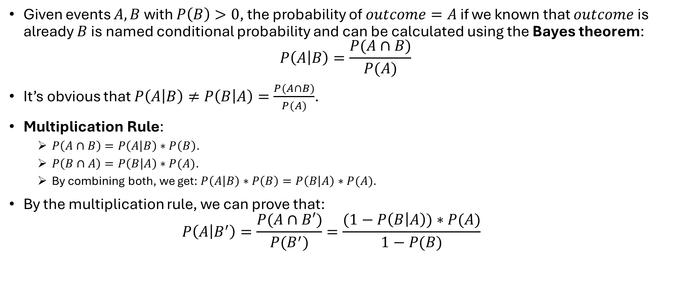
Bayes Theorem
Given events $A,B$ with $P\left(B\right)>0$, the probability of $outcome=A$ if we known that $outcome$ is already $B$ is named conditional probability and can be calculated using the Bayes theorem:
$$P\left(A | B\right)=\frac{P(A∩B)}{P(A)}$$
It’s obvious that $P\left(A | B\right)≠P\left(B | A\right)=\frac{P(A∩B)}{P(A)}$.
Multiplication Rule:
$P\left(A∩B\right)=P\left(A | B\right)∗P\left(B\right)$.
$P\left(B∩A\right)=P\left(B | A\right)∗P(A)$.
By combining both, we get: $P\left(A | B\right)∗P\left(B\right)=P\left(B | A\right)∗P(A)$.
By the multiplication rule, we can prove that:
$$P\left(A | B^{′}\right)=\frac{P(A∩B′)}{P(B^{′})}=\frac{(1−P\left(B | A\right))∗P(A)}{1−P(B)}$$

Slide 6
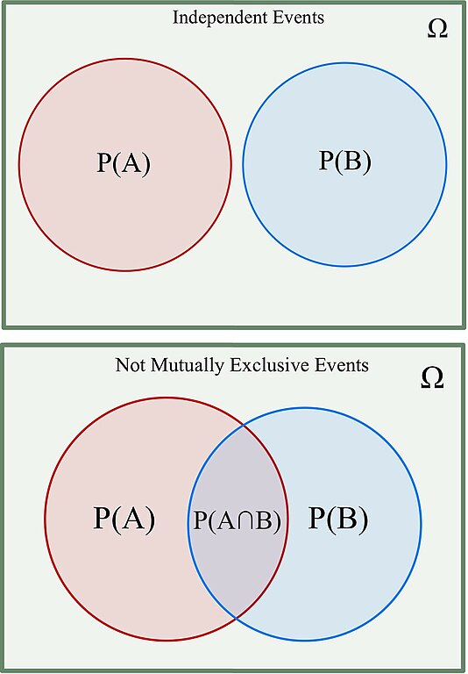

Independent Events
Two events $A,B$ with $P\left(B\right)>0$are called independent if $A∩B=\{\}$.
In this case $P\left(A∩B\right)=P(A)∙P(B)$.
From Bayes theorem: $P\left(A | B\right)=P(A)$ if $A,B$ are independent.

Slide 7
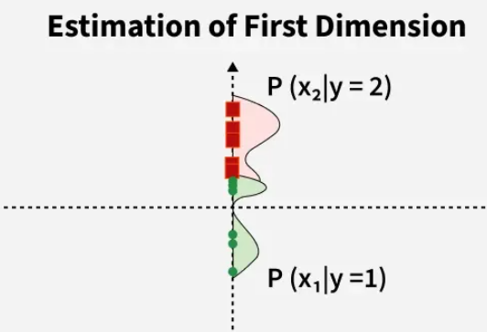
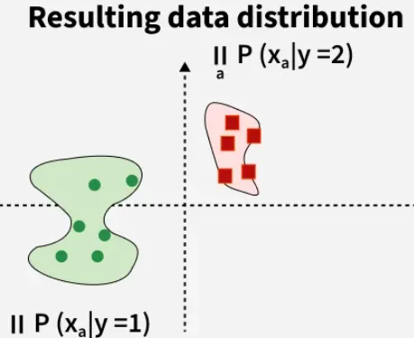
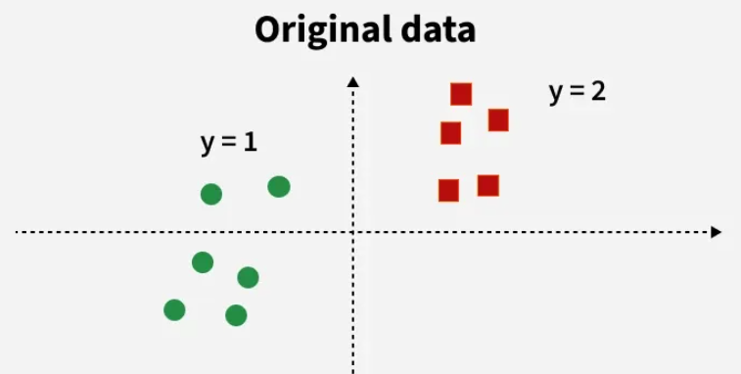
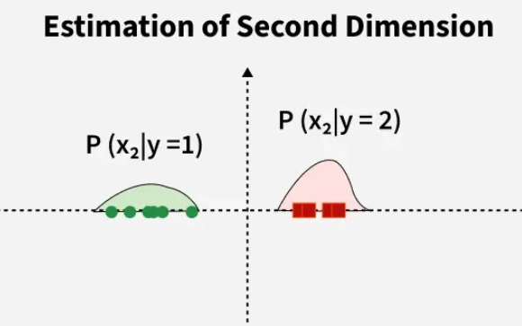
Naïve Bayes Classifier
Naive Bayes is a classification algorithm that predicts the category of a data point using the bayes theorem.
It assumes that all features are independent of each other (this is why it is called “Naive”).
Works only with categorical data, but it can be extended to work with continuous variables as well.
Applications:
Spam filtering.
Document categorization.
Sentiment analysis.

Slide 8
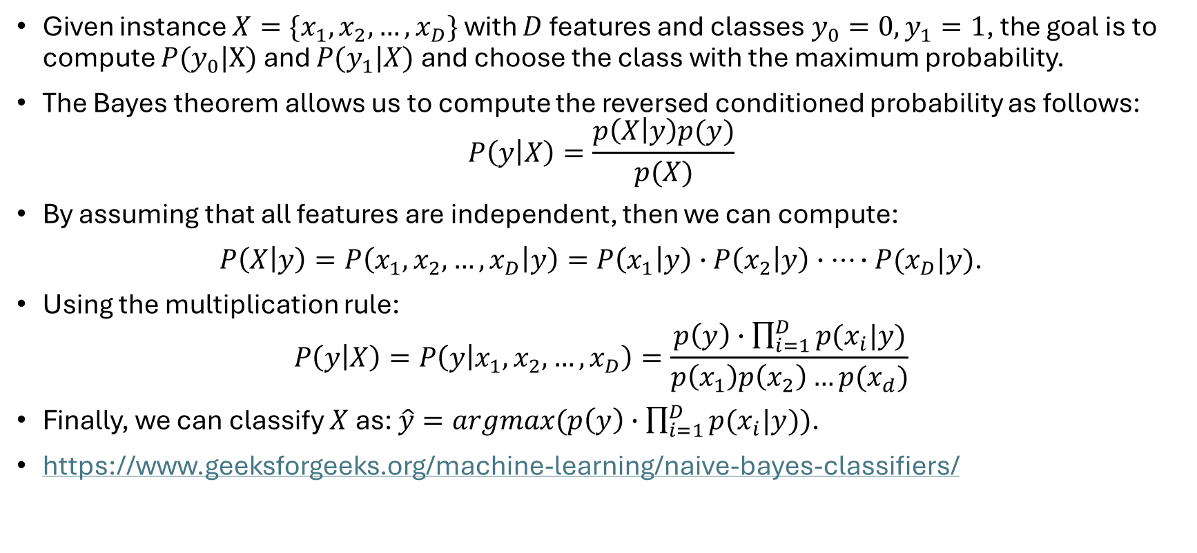
Naïve Bayes Method
Given instance $X=\{x_{1},x_{2},…,x_{D}\}$ with $D$ features and classes $y_{0}=0,y_{1}=1$, the goal is to compute $P(y_{0}|X)$ and $P(y_{1}|X)$ and choose the class with the maximum probability.
The Bayes theorem allows us to compute the reversed conditioned probability as follows: $P\left(y | X\right)=\frac{p\left(X | y\right)p(y)}{p(X)}$
By assuming that all features are independent, then we can compute:
$P\left(X | y\right)=P\left(x_{1},x_{2},…,x_{D} | y\right)=P\left(x_{1} | y\right)∙P\left(x_{2} | y\right)∙…∙P(x_{D}|y)$.
Using the multiplication rule:
$$P\left(y | X\right)=P\left(y | x_{1},x_{2},…,x_{D}\right)=\frac{p\left(y\right)∙\prod_{i=1}^{D}{p(x_{i}|y})}{p\left(x_{1}\right)p\left(x_{2}\right)…p(x_{d})}$$
Finally, we can classify $X$ as: $\hat{y}=argmax(p\left(y\right)∙\prod_{i=1}^{D}{p(x_{i}|y}))$.
https://www.geeksforgeeks.org/machine-learning/naive-bayes-classifiers/

Slide 9
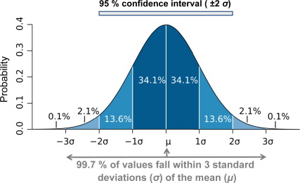
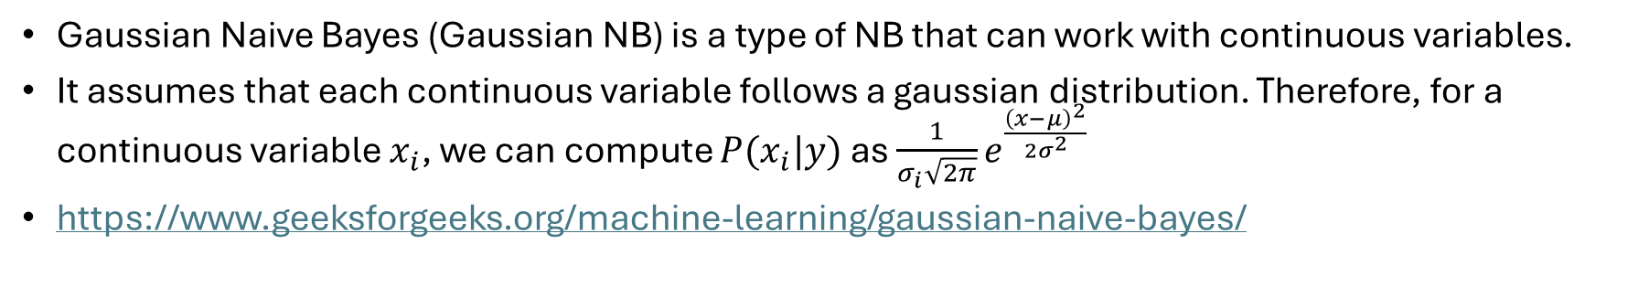
Gaussian Naïve Bayes
Gaussian Naive Bayes (Gaussian NB) is a type of NB that can work with continuous variables.
It assumes that each continuous variable follows a gaussian distribution. Therefore, for a continuous variable $x_{i}$, we can compute $P(x_{i}|y)$ as $\frac{1}{σ_{i}\sqrt{2π}}e^{\frac{{\left(x−μ\right)}^{2}}{2σ^{2}}}$
https://www.geeksforgeeks.org/machine-learning/gaussian-naive-bayes/

Slide 10
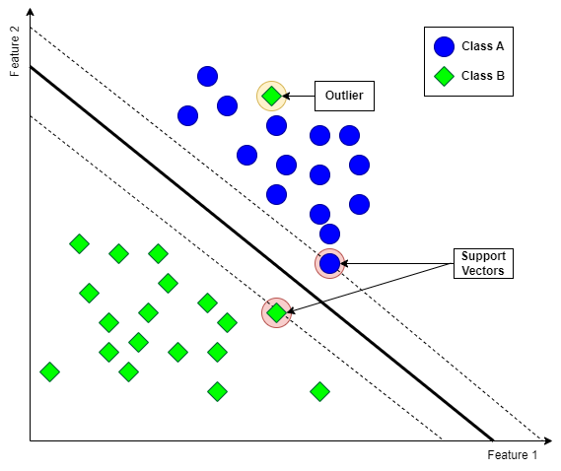
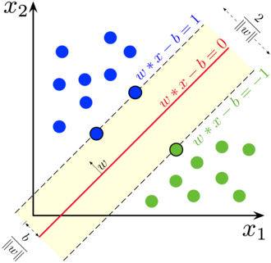
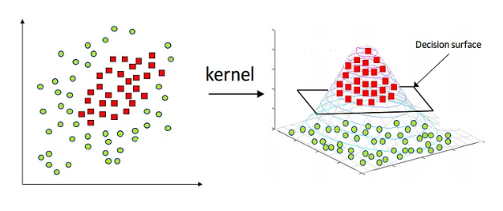
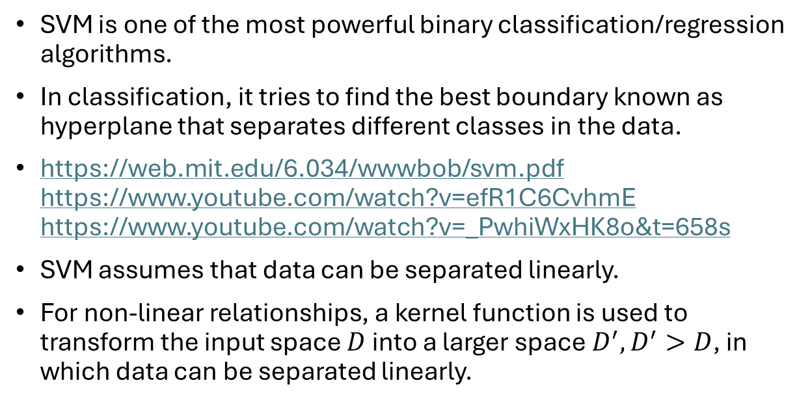
Support Vector Machine (SVM)
SVM is one of the most powerful binary classification/regression algorithms.
In classification, it tries to find the best boundary known as hyperplane that separates different classes in the data.
https://web.mit.edu/6.034/wwwbob/svm.pdf https://www.youtube.com/watch?v=efR1C6CvhmE https://www.youtube.com/watch?v=_PwhiWxHK8o&t=658s
SVM assumes that data can be separated linearly.
For non-linear relationships, a kernel function is used to transform the input space $D$ into a larger space $D^{′}, D^{′}>D$, in which data can be separated linearly.

Slide 11
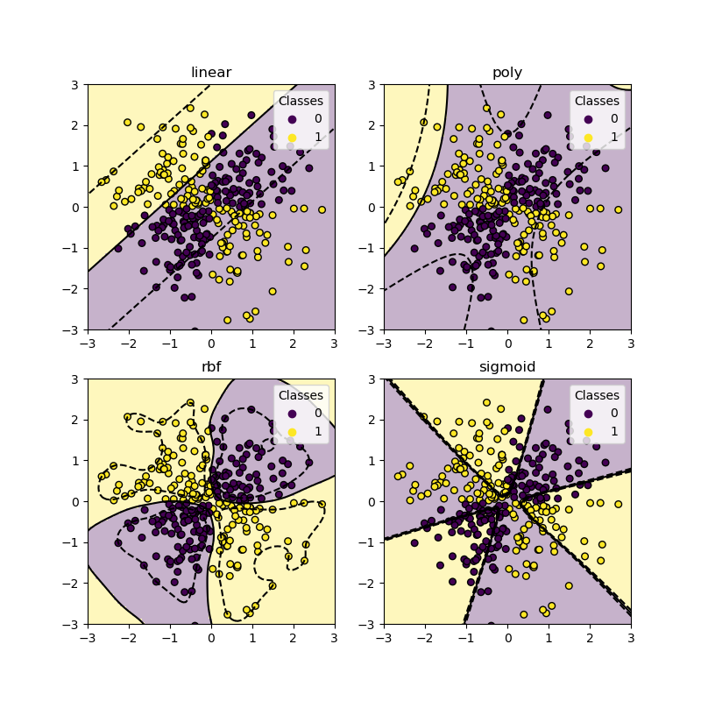
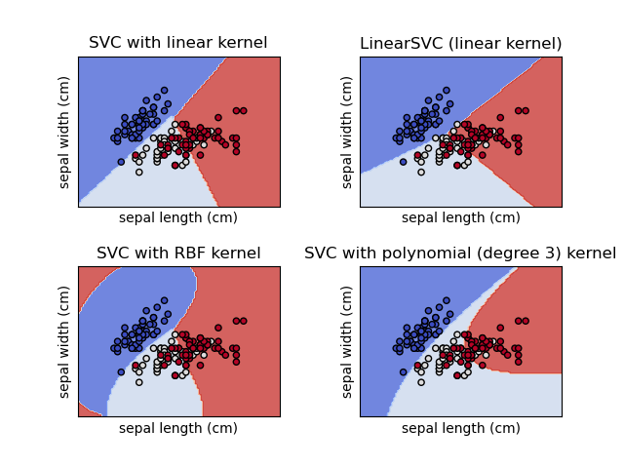
SVM Kernels
Linear
RBF
Sigmoid
Polynomial
Each kernel transforms the input space differently.

Slide 12
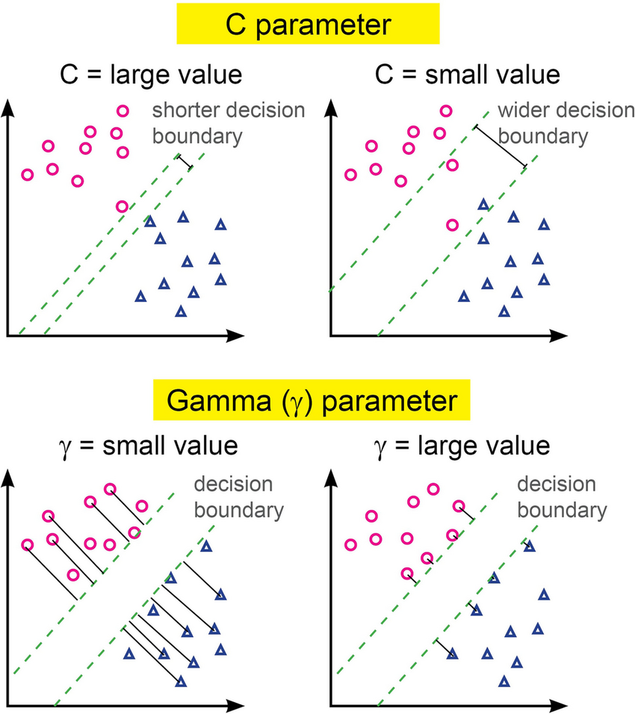
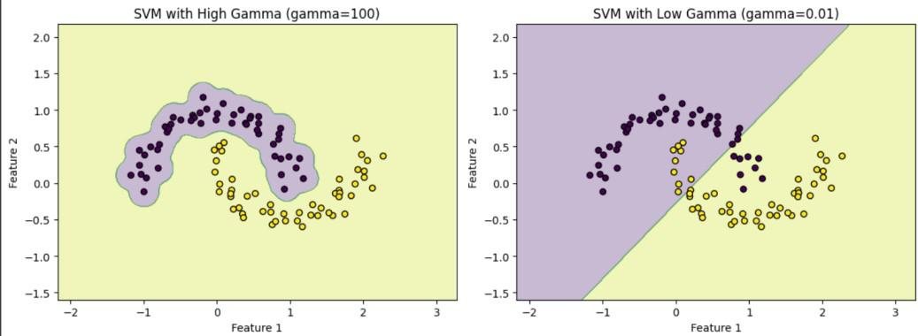
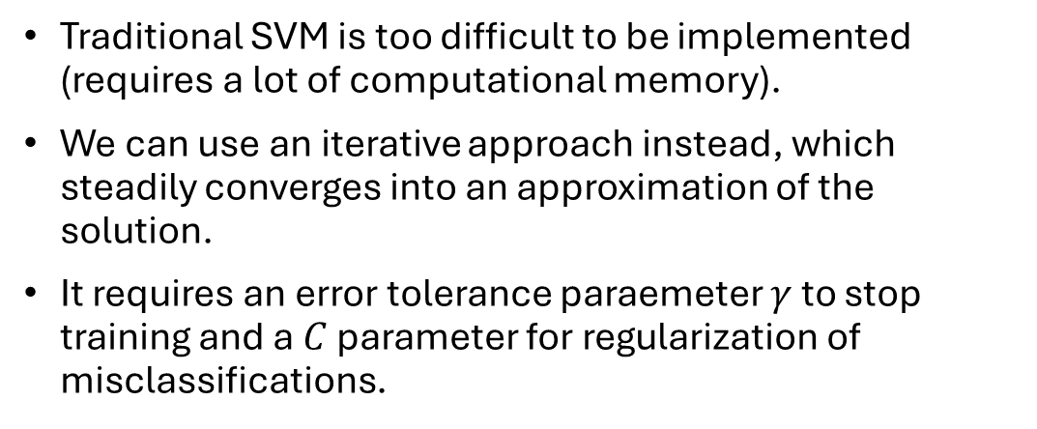
Error Sensitivity
Traditional SVM is too difficult to be implemented (requires a lot of computational memory).
We can use an iterative approach instead, which steadily converges into an approximation of the solution.
It requires an error tolerance paraemeter $γ$ to stop training and a $C$ parameter for regularization of misclassifications.

Slide 13
SVM Strengths & Weaknesses
Advantages:
High-Dimensional Performance: SVM excels in high-dimensional spaces.
Nonlinear Capability: Utilizing kernel functions like RBF and polynomial SVM effectively handles nonlinear relationships.
Outlier Resilience: The soft margin feature allows SVM to ignore outliers, enhancing robustness in spam detection and anomaly detection.
Disadvantages:
Slow Training: SVM can be slow in large datasets with many instances (rows) and features (columns).
Noise Sensitivity: SVM struggles with noisy datasets and overlapping classes.
Limited Interpretability: The complexity of the hyperplane in higher dimensions makes SVM less interpretable than other models.
Feature Scaling Sensitivity: Proper feature scaling is essential, otherwise SVM models may perform poorly.
Overfitting: The use of kernel function can increase the performance in the training set, but increases the risk of overfitting.

Slide 14
Machine Learning
Naïve Bayes & SVM

